Slide 1
Linux Basic
Chason DU
29-11-2016

Slide 2

Contents
What is LINUX?
Linux History
Linux is Not Windows
Linux Philosophies
Linux Booting
The Directory Structure
File System Basic
Reference

Slide 3
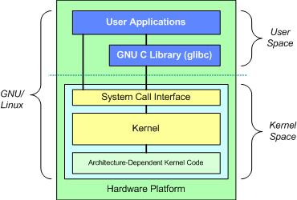
What is LINUX?
Linux is a Unix-like computer operating system assembled under the model of free and open-source software development and distribution. The defining component of Linux is the Linux kernel.
A Linux distribution is built on top of the Linux kernel, including a large collection of software applications such as word processors, media players, and database applications.
RHEL(Red Hat Enterprise Linux)
Fedora/CentOS
SLES(SUSE Linux Enterprise Server)/OpenSUSE
Debian/Ubuntu
Google's Android
Notes:
Ubuntu（友帮拓、优般图、乌班图）是一个以桌面应用为主的开源GNU/Linux操作系统，Ubuntu 是基于Debian GNU/Linux.
Debian（蝶变、玳斌，待宾）
Fedora（英 [fɪ'dɔːrə]，美 [fɪ'dɔrə] ）是一个 Linux 发行版，是一款由全球社区爱好者构建的面向日常应用的快速、稳定、强大的操作系统。
# uname –a: same with /proc/version
Linux localhost.localdomain 2.6.32-431.el6.x86_64 #1 SMP Fri Nov 22 03:15:09 UTC 2013 x86_64 x86_64 x86_64 GNU/Linux
# lsb_release -a: Linux Standard Base
LSB Version: :base-4.0-amd64:base-4.0-noarch:core-4.0-amd64:core-4.0-noarch:graphics-4.0-amd64:graphics-4.0-noarch:printing-4.0-amd64:printing-4.0-noarch
Distributor ID: CentOS
Description: CentOS release 6.5 (Final)
Release: 6.5
Codename: Final
# cat /proc/version
Linux version 2.6.32-431.el6.x86_64 (mockbuild@c6b8.bsys.dev.centos.org) (gcc version 4.4.7 20120313 (Red Hat 4.4.7-4) (GCC) ) #1 SMP Fri Nov 22 03:15:09 UTC 2013
# cat /etc/issue
CentOS release 6.5 (Final)
Kernel \r on an \m
# cat /etc/redhat-release
CentOS release 6.5 (Final)

Slide 4
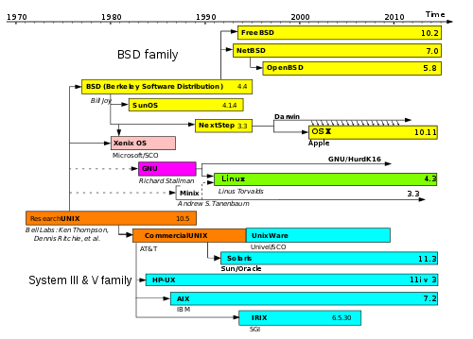
Linux History
Simplified history of Unix-like operating systems. Linux shares similar architecture and concepts (as part of the POSIX standard) but does not share non-free source code with the original Unix or MINIX.

Slide 5
Linux is Not Windows
Windows | Linux
For non-technical users | For engineers, scientists etc.
Fancy and easy to use, GUI | Efficiency, CLI
Proprietary and private | Free and open
Good for entertainment | Wonderful working environment

Slide 6

Linux Philosophies
Silence is Golden
Write programs that do one thing and do it well.
Write programs to work together.
Write programs to handle text stream

Slide 7
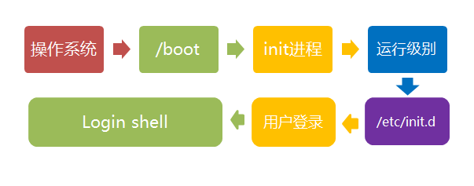
Linux Booting
/boot/vmlinuz-2.6.32-431.el6.x86_64
/etc/inittab(default runlevel), /etc/rc.d/rc[0123456].d
Runlevel: output previous and current runlevel
Init: change current runlevel
Notes:
BIOS: Basic Input Output System找到可启动设备
-> MBR(引导代码：前446字节,找到并加载内核)
-> GRUB(boot/grub/grub.conf)
-> Kernel(不常用的驱动、功能编译成为模块，在需要的时候动态加载，而这些模块被打包保存为一个initrd/initramfs文件)
-> Init(调用/etc/rc.d/rc.sysinit负责对系统进行初始化，挂载文件系统，并且根据运行级别启动相应服务)
title CentOS
root(hd0,1)
kernel /boot/vmlinuz-2.6.32-279.el6.i686 ro root=UUID=77272833-
B6BB-4D53-B043-9541D1102EBD single
initrd /boot/initramfs-2.6.32-279.el6.i686.img
Ctrl + Alt + F1 ~ F6: 命令窗口界面。
Ctrl + Alt + F7:图形界面
如果你用的vmware 虚拟机，
命令窗口切换: Alt + Space + F1~F6.
图形界面下: Alt + Shift + Ctrl + F1~F6
[root@binjiang-hz-dhcp086188 rc.d]# ls -l /etc/systemd/system/multi-user.target.wants/
total 0
lrwxrwxrwx. 1 root root 36 Apr 4 2015 sshd.service -> /usr/lib/systemd/system/sshd.service

Slide 8
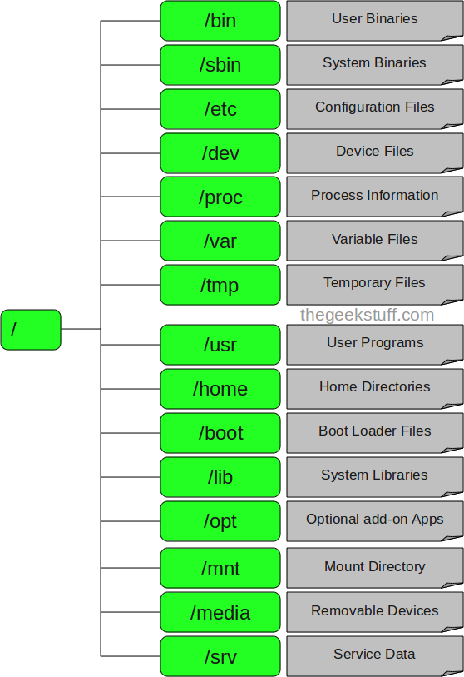
The Directory Structure
Hierarchical
The top of the hierarchy is traditionally called root (written as a slash / ).
/bin: used by all the users, ps, ls, ping, grep, cp …
/sbin: system aministrator, for system maintenance purpose, iptables, reboot, fdisk, ifconfig …
/etc: /etc/resolv.conf, /etc/logrotate.conf
/var: content of the files that are expected to grow, /var/log, /var/mail …
/home: home directories for all users to store their personal files
/usr: second level user programs

Slide 9
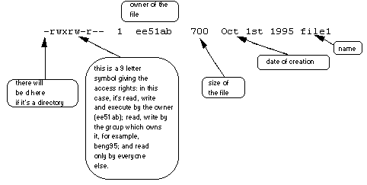
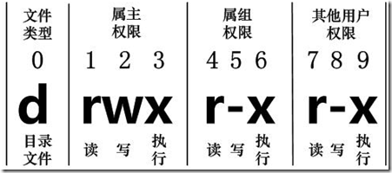
File System Basic: UGO model
Each file (and directory) has associated access rights, which may be found by typing ls -l.
[d]: directory, [-]: file, [l]: link file, [b]:, [c]:

Slide 10
Get Help
Command arguments: -h, --help
Man command: format and display the on-line manual pages
Example: man 2 socket; man –k socket
Info
/usr/share/doc
Section | Type
1 | User Commands
2 | System Calls
3 | C Library Functions
4 | Devices and Special Files
5 | File Formats and Conventions
6 | Games et. Al.
7 | Miscellanea
8 | System Administration tools and Deamons
9 | Linux Kernel

Slide 11
Reference
鸟哥的Linux私房菜：基础学习篇（第三版）
Linux入门基础，苏勇，http://study.163.com/course/introduction/232007.htm#/courseDetail
Get Started with Linux: Introduction to Linux and Shell Scripting, ark.fang

Slide 12


